Slide 1
Screenshots
CSE 581

Slide 2
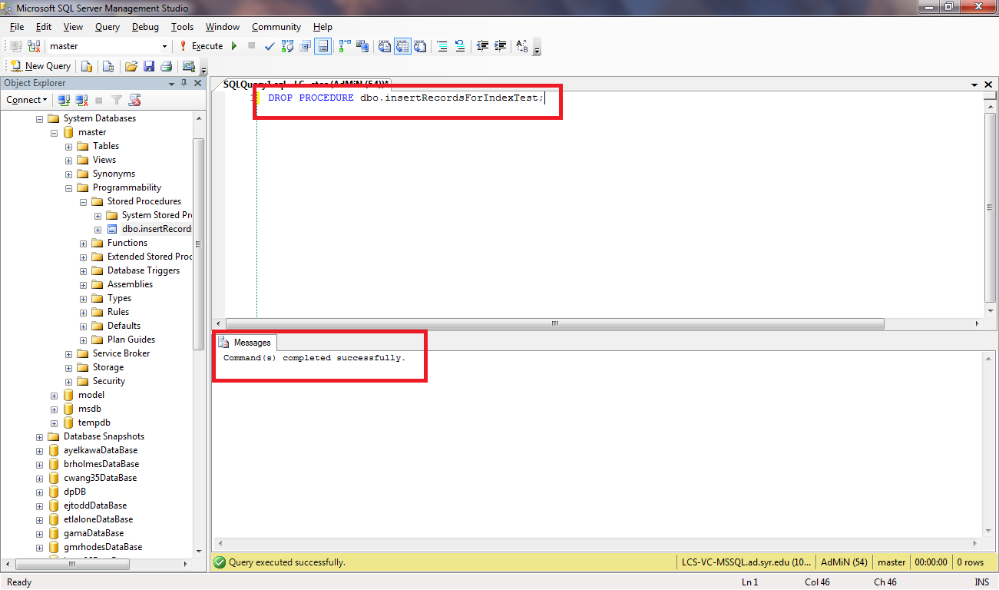
Command Execution

Slide 3
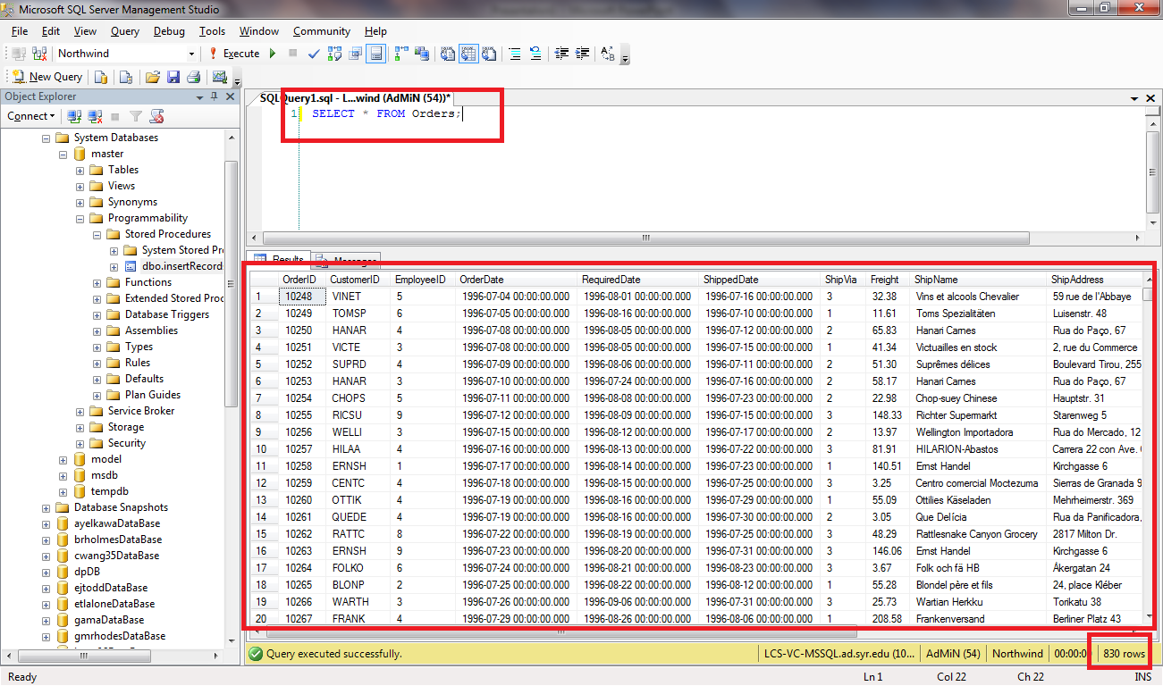
Data Selection

